Slide 1
Computer Networks Lecture Series
Course Details
Course Code | 18CS51 | Credits | 4
Course type | PC | CIE Marks | 50 marks
Hours/week: L-T-P | 3 – 2 – 0 | SEE Marks | 50 marks
Total Hours: | Lecture = 40 Hrs; Tutorial = 10Hrs Total = 50 Hrs | SEE Duration | 3 Hours for 100 marks
Lecture Topic:
UNIT-1: Introduction to Computer Networks and the Internet
Lecture Delivery By:
Dr. Umesh M. Kulkarni
Prof. P. M. Pujar
Prof. Amruta Deshpande,
Department of CSE, KLS GIT, Belagavi

Slide 2
ACKNOWLEDGMENT
SPECIAL THANKS TO THE AUTHORS
Jim Kurose and Keith Ross
&
THE PUBLISHERS Addison-Wesley

Slide 3
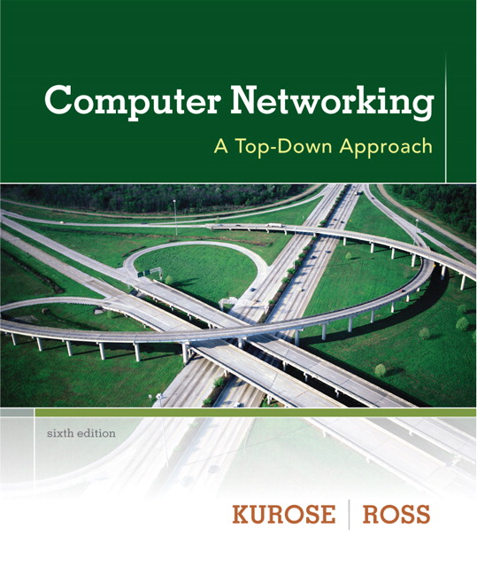

Chapter 1 Introduction
A note on the use of these ppt slides:
We’re making these slides freely available to all (faculty, students, readers). They’re in PowerPoint form so you see the animations; and can add, modify, and delete slides (including this one) and slide content to suit your needs. They obviously represent a lot of work on our part. In return for use, we only ask the following:
Computer Networking: A Top Down Approach 6th edition Jim Kurose, Keith Ross Addison-Wesley March 2012
If you use these slides (e.g., in a class) that you mention their source (after all, we’d like people to use our book!)
If you post any slides on a www site, that you note that they are adapted from (or perhaps identical to) our slides, and note our copyright of this material.
Thanks and enjoy! JFK/KWR
All material copyright 1996-2012
J.F Kurose and K.W. Ross, All Rights Reserved
The course notes are adapted for Bucknell’s CSCI 363
Xiannong Meng
Spring 2016

Slide 4
Course Learning Objectives
Elucidate basic computer networking.
Demonstration of application layer protocols application layer protocols.
Discuss transport layer services and understand UDP and TCP protocols.
Explain routers, IP and Routing Algorithms in network layer.
Demonstrate the error detection and correction at link layer.

Slide 5
Course outcomes
Demonstrate the use of computer networking and layering concept
Explain principles of application layer protocols
Recognize transport layer services and infer UDP and TCP protocols
Classify routers, IP and Routing Algorithms in network layer
Performing error detection and correction at link layer

Slide 6
Syllabus and tentative schedule
Course website at http://www.eg.bucknell.edu/~cs363/
Go through the syllabus at http://www.eg.bucknell.edu/~cs363/2016-spring/syllabus.html
Academic responsibility!
Inclusive environment!
A tentative schedule at http://www.eg.bucknell.edu/~cs363/2016-spring/schedule.html

Slide 7
What is in the “overview”?
what’s the Internet?
what’s a protocol?
network edge: hosts, access net, physical media
network core: packet/circuit switching, Internet structure
performance: loss, delay, throughput
security
protocol layers, service models
history

Slide 8



















What’s the Internet: “nuts and bolts” view
PC
millions of connected computing devices:
hosts = end systems
running network apps
mobile network
server
wireless
laptop
global ISP
smartphone
home
network
communication links
fiber, copper, radio, satellite
transmission rate: bandwidth
regional ISP
wireless
links
wired
links
Packet switches: forward packets (chunks of data)
routers and switches
router
institutional
network
Notes:
‹#›

Slide 9


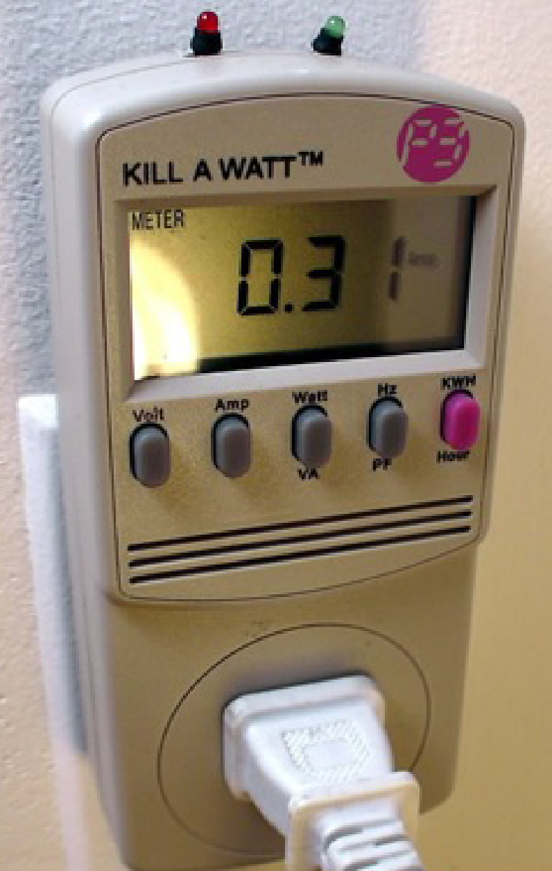




“Fun” internet appliances -- Internet of Things
Web-enabled toaster +
weather forecaster
IP picture frame
http://www.ceiva.com/
Tweet-a-watt:
monitor energy use
Slingbox: watch,
control cable TV remotely
Internet
refrigerator
Internet apps in cars we drive
Internet phones

Slide 10
What’s the Internet: “nuts and bolts” view
Internet: “network of networks”
Interconnected ISPs
Protocols: control sending, receiving of information
e.g., TCP, IP, HTTP, Skype, 802.11
Internet standards:
RFC: Request for comments
IETF: Internet Engineering Task Force
mobile network
global ISP
home
network
regional ISP
institutional
network

Slide 11
What’s the Internet: a service view
mobile network
Infrastructure that provides services to applications:
Web, VoIP, email, games, e-commerce, social nets, …
Infrastructure that provides programming interface to apps
hooks that allow sending and receiving app programs to “connect” to Internet
global ISP
home
network
regional ISP
institutional
network

Slide 12
What’s a protocol?
human protocols:
“knock, knock, who’s there”
Call through phones
Introductions
… specific msgs sent
… specific actions taken when msgs received, or other events
network protocols:
machines rather than humans
all communication activity in Internet governed by protocols
protocols define format, order of msgs sent and received among network entities, and actions taken on msg transmission, receipt

Slide 13



What’s a protocol?
a human protocol and a computer network protocol:
Hi
TCP connection
request
Hi
TCP connection
response
Got the
time?
Get http://www.awl.com/kurose-ross
2:00
<file>
time
Q: other human protocols?

Slide 14
Chapter 1: roadmap
1.1 what is the Internet?
1.2 network edge
end systems, access networks, links
1.3 network core
packet switching, circuit switching, network structure
1.4 delay, loss, throughput in networks
1.5 protocol layers, service models
1.6 networks under attack: security
1.7 history
Notes:
‹#›

Slide 15


A closer look at network structure:
network edge:
hosts: clients and servers
servers often in data centers
mobile network
global ISP
access networks, physical media: wired, wireless communication links
home
network
regional ISP
network core:
interconnected routers
network of networks
institutional
network

Slide 16

Access networks and physical media
Q: How to connect end systems to edge router?
residential access nets
institutional access networks (school, company)
mobile access networks
keep in mind:
bandwidth (bits per second) of access network?
shared or dedicated?

Slide 17

Access net: digital subscriber line (DSL)
central office
telephone
network
DSL
modem
splitter
DSLAM
ISP
voice, data transmitted
at different frequencies over
dedicated line to central office
DSL access
multiplexer
Frequency division multiplexing (FDM)

Slide 18
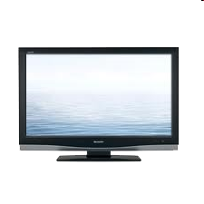


Access net: cable network
cable headend
…
cable
modem
splitter
C
O
N
T
R
O
L
V
I
D
E
O
V
I
D
E
O
V
I
D
E
O
V
I
D
E
O
V
I
D
E
O
V
I
D
E
O
D
A
T
A
D
A
T
A
1
2
3
4
5
6
7
8
9
Channels
frequency division multiplexing: different channels transmitted
in different frequency bands

Slide 19
FDM versus TDM
Example:
FDM
4 users
frequency
time
TDM
frequency
time
Notes:
Two simple multiple access control techniques.
Each mobile’s share of the bandwidth is divided into portions for the uplink and the downlink. Also, possibly, out of band signaling.
As we will see, used in AMPS, GSM, IS-54/136

Slide 20





Access net: home network
wireless
devices
to/from headend or central office
often combined
in single box
cable or DSL modem
wireless access
point (54 Mbps)
router, firewall, NAT
wired Ethernet (100 Mbps)

Slide 21









Enterprise access networks (Ethernet)
institutional link to
ISP (Internet)
institutional router
Ethernet
switch
institutional mail,
web servers
typically used in companies, universities, etc
10 Mbps, 100Mbps, 1Gbps, 10Gbps transmission rates
today, end systems typically connect into Ethernet switch

Slide 22
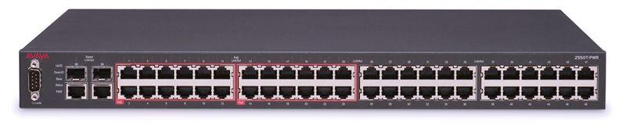
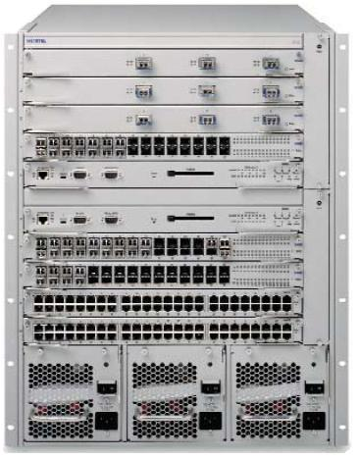
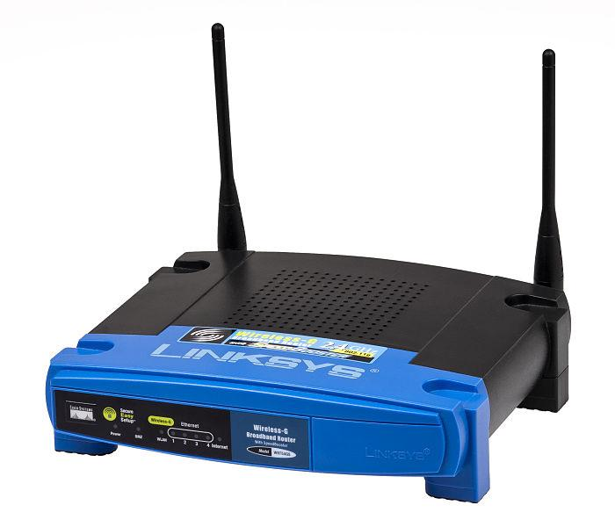
Ethernet Switches, Routers
http://en.wikipedia.org/wiki/Network_switch
http://en.wikipedia.org/wiki/Router_(computing)
http://en.wikipedia.org/wiki/Wireless_router

Slide 23








Wireless access networks
shared wireless access network connects end system to router
via base station a.k.a. “access point”
wide-area wireless access
provided by telco (cellular) operator, 10’s km
between 1 and 10 Mbps
3G, 4G: LTE
wireless LANs:
within building (100 ft)
802.11b/g (WiFi): 11, 54 Mbps transmission rate
to Internet
to Internet

Slide 24


Host: sends packets of data
host sending function:
takes application message
breaks into smaller chunks, known as packets, of length L bits
transmits packet into access network at transmission rate R
link transmission rate, a.k.a. link capacity, aka link bandwidth
two packets,
L bits each
2
1
R: link transmission rate
host

Slide 25
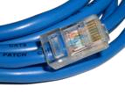
Physical media
bit: propagates between transmitter/receiver pairs
physical link: what lies between transmitter & receiver
guided media:
signals propagate in solid media: copper, fiber, coax
unguided media:
signals propagate freely, e.g., radio
twisted pair (TP)
two insulated copper wires
Category 5: 100 Mbps, 1 Gpbs Ethernet
Category 6: 10Gbps

Slide 26


Physical media: coax, fiber
coaxial cable:
two concentric copper conductors
bidirectional
broadband:
multiple channels on cable
HFC
fiber optic cable:
glass fiber carrying light pulses, each pulse a bit
high-speed operation:
high-speed point-to-point transmission (e.g., 10’s-100’s Gpbs transmission rate)
low error rate:
repeaters spaced far apart
immune to electromagnetic noise

Slide 27
Physical media: radio
signal carried in electromagnetic spectrum
no physical “wire”
bidirectional
propagation environment effects:
reflection
obstruction by objects
interference
radio link types:
terrestrial microwave
e.g. up to 45 Mbps channels
LAN (e.g., WiFi)
11Mbps, 54 Mbps
wide-area (e.g., cellular)
3G cellular: ~ few Mbps
4G LTE: 10s to 100s Mbps
satellite
Kbps to 45Mbps channel (or multiple smaller channels)
270 msec end-end delay
geosynchronous versus low altitude

Slide 28
Chapter 1: roadmap
1.1 what is the Internet?
1.2 network edge
end systems, access networks, links
1.3 network core
packet switching, circuit switching, network structure
1.4 delay, loss, throughput in networks
1.5 protocol layers, service models
1.6 networks under attack: security
1.7 history
Notes:
‹#›

Slide 29









The network core
mesh of interconnected routers
packet-switching: hosts break application-layer messages into packets
forward packets from one router to the next, across links on path from source to destination
each packet transmitted at full link capacity

Slide 30
Packet Switching: queueing delay, loss
R = 100 Mb/s
C
A
D
R = 1.5 Mb/s
B
E
queue of packets
waiting for output link
queuing and loss:
If arrival rate (in bits) to link exceeds transmission rate of link for a period of time:
packets will queue, wait to be transmitted on link
packets can be dropped (lost) if memory (buffer) fills up

Slide 31
Two key network-core functions
routing: determines source-destination route taken by packets
routing algorithms
forwarding: move packets from router’s input to appropriate router output
routing algorithm
local forwarding table
header value
output link
0100
0101
0111
1001
3
2
2
1
1
3
2
0111
dest address in arriving
packet’s header

Slide 32
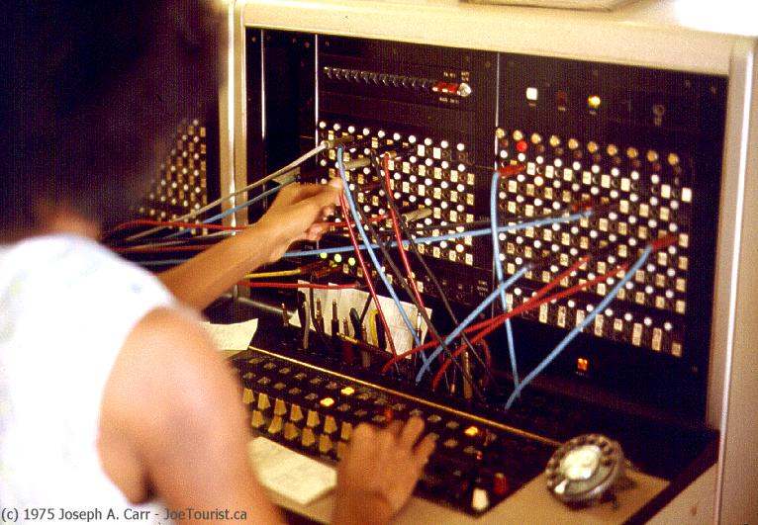
Alternative core: circuit switching
end-end resources allocated to, reserved for “call” between source & destination:
In diagram, each link has four circuits.
call gets 2nd circuit in top link and 1st circuit in right link.
Dedicated resources: no sharing
circuit-like (guaranteed) performance
Circuit segment idle if not used by call (no sharing)
Commonly used in traditional telephone networks

Slide 33
Internet structure: network of networks
End systems connect to Internet via access ISPs (Internet Service Providers)
Residential, company and university ISPs
Access ISPs in turn must be interconnected.
So that any two hosts can send packets to each other
Resulting network of networks is very complex
Evolution was driven by economics and national policies
Let’s take a stepwise approach to describe current Internet structure

Slide 34
Internet structure: network of networks
Question: given millions of access ISPs, how to connect them together?
…
…
access
net
access
net
access
net
access
net
access
net
access
net
access
net
…
…
access
net
access
net
access
net
access
net
access
net
access
net
…
access
net
access
net
…
access
net

Slide 35
Internet structure: network of networks
Option: connect each access ISP to every other access ISP?
…
…
access
net
access
net
access
net
access
net
access
net
…
…
access
net
access
net
…
connecting each access ISP to each other directly doesn’t scale: O(N²) connections.
…
…
access
net
access
net
…
access
net
access
net
access
net
…
access
net
…
access
net
access
net
…
access
net

Slide 36
Internet structure: network of networks
Option: connect each access ISP to a global transit ISP? Customer and provider ISPs have economic agreement.
…
…
access
net
access
net
access
net
access
net
access
net
access
net
access
net
…
…
global ISP
access
net
access
net
access
net
access
net
access
net
access
net
…
access
net
access
net
…
access
net

Slide 37
Internet structure: network of networks
But if one global ISP is viable business, there will be competitors ….
…
…
access
net
access
net
access
net
access
net
access
net
access
net
access
net
ISP A
…
…
access
net
ISP B
access
net
ISP C
access
net
access
net
access
net
access
net
…
access
net
access
net
…
access
net

Slide 38
Internet structure: network of networks
But if one global ISP is viable business, there will be competitors …. which must be interconnected
Internet exchange point
…
…
access
net
access
net
access
net
access
net
access
net
IXP
access
net
access
net
ISP A
…
…
IXP
access
net
access
net
ISP B
ISP C
access
net
access
net
peering link
access
net
access
net
…
access
net
access
net
…
access
net

Slide 39
Internet structure: network of networks
… and regional networks may arise to connect access nets to ISPS
…
…
access
net
access
net
access
net
access
net
access
net
IXP
access
net
access
net
ISP A
…
…
IXP
access
net
access
net
ISP B
ISP C
access
net
access
net
access
net
regional net
access
net
…
access
net
access
net
…
access
net

Slide 40
Internet structure: network of networks
… and content provider networks (e.g., Google, Microsoft, Akamai ) may run their own network, to bring services, content close to end users
…
…
access
net
access
net
access
net
access
net
access
net
IXP
access
net
access
net
ISP A
…
…
Content provider network
IXP
access
net
access
net
ISP B
ISP B
access
net
access
net
access
net
regional net
access
net
…
access
net
access
net
…
access
net

Slide 41
Internet structure: network of networks
Tier 1 ISP
Tier 1 ISP
Google
IXP
IXP
IXP
Regional ISP
Regional ISP
access
ISP
access
ISP
access
ISP
access
ISP
access
ISP
access
ISP
access
ISP
access
ISP
at center: small # of well-connected large networks
“tier-1” commercial ISPs (e.g., Level 3, Sprint, AT&T, NTT), national & international coverage
content provider network (e.g, Google): private network that connects it data centers to Internet, often bypassing tier-1, regional ISPs

Slide 42
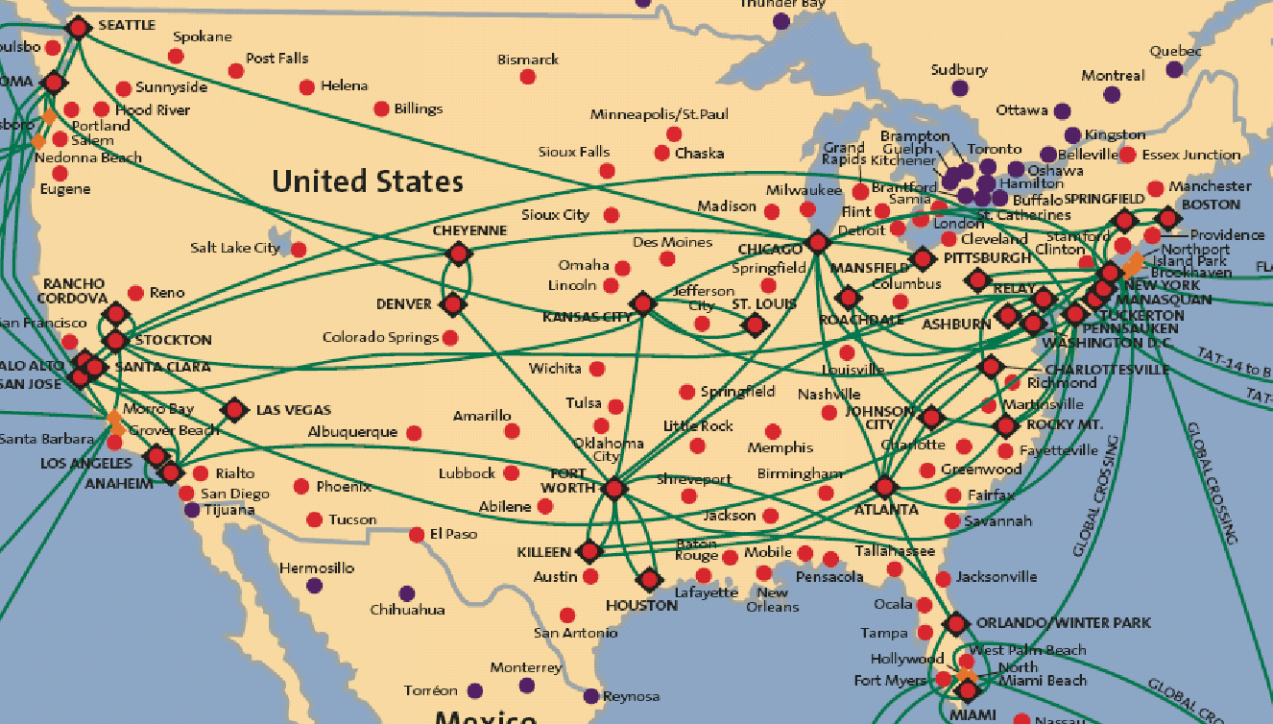
Tier-1 ISP: e.g., Verizon, ATT, Sprint
POP: point-of-presence
to/from backbone
peering
…
…
…
…
…
to/from customers

Slide 43
Chapter 1: roadmap
1.1 what is the Internet?
1.2 network edge
end systems, access networks, links
1.3 network core
packet switching, circuit switching, network structure
1.4 delay, loss, throughput in networks
1.5 protocol layers, service models
1.6 networks under attack: security
1.7 history
Notes:
‹#›

Slide 44
“Real” Internet delays and routes
what do “real” Internet delay & loss look like?
traceroute program: provides delay measurement from source to router along end-end Internet path towards destination. For all i:
sends three packets that will reach router i on path towards destination
router i will return packets to sender
sender times interval between transmission and reply.
3 probes
3 probes
3 probes

Slide 45
“Real” Internet delays, routes
traceroute: gaia.cs.umass.edu to www.eurecom.fr
3 delay measurements from
gaia.cs.umass.edu to cs-gw.cs.umass.edu
1 cs-gw (128.119.240.254) 1 ms 1 ms 2 ms
2 border1-rt-fa5-1-0.gw.umass.edu (128.119.3.145) 1 ms 1 ms 2 ms
3 cht-vbns.gw.umass.edu (128.119.3.130) 6 ms 5 ms 5 ms
4 jn1-at1-0-0-19.wor.vbns.net (204.147.132.129) 16 ms 11 ms 13 ms
5 jn1-so7-0-0-0.wae.vbns.net (204.147.136.136) 21 ms 18 ms 18 ms
6 abilene-vbns.abilene.ucaid.edu (198.32.11.9) 22 ms 18 ms 22 ms
7 nycm-wash.abilene.ucaid.edu (198.32.8.46) 22 ms 22 ms 22 ms
8 62.40.103.253 (62.40.103.253) 104 ms 109 ms 106 ms
9 de2-1.de1.de.geant.net (62.40.96.129) 109 ms 102 ms 104 ms
10 de.fr1.fr.geant.net (62.40.96.50) 113 ms 121 ms 114 ms
11 renater-gw.fr1.fr.geant.net (62.40.103.54) 112 ms 114 ms 112 ms
12 nio-n2.cssi.renater.fr (193.51.206.13) 111 ms 114 ms 116 ms
13 nice.cssi.renater.fr (195.220.98.102) 123 ms 125 ms 124 ms
14 r3t2-nice.cssi.renater.fr (195.220.98.110) 126 ms 126 ms 124 ms
15 eurecom-valbonne.r3t2.ft.net (193.48.50.54) 135 ms 128 ms 133 ms
16 194.214.211.25 (194.214.211.25) 126 ms 128 ms 126 ms
17 * * *
18 * * *
19 fantasia.eurecom.fr (193.55.113.142) 132 ms 128 ms 136 ms
trans-oceanic
link
* means no response (probe lost, router not replying)
* Do some traceroutes from exotic countries at www.traceroute.org

Slide 46
Packet loss
queue (aka buffer) preceding link in buffer has finite capacity
packet arriving to full queue dropped (aka lost)
lost packet may be retransmitted by previous node, by source end system, or not at all
buffer
(waiting area)
A
packet being transmitted
B
packet arriving to
full buffer is lost
* Check out the Java applet for an interactive animation on queuing and loss

Slide 47
Throughput
throughput: rate (bits/time unit) at which bits transferred between sender/receiver
instantaneous: rate at given point in time
average: rate over longer period of time
server, with
file of F bits
to send to client
link capacity
R_{s} bits/sec
link capacity
R_{c} bits/sec
server sends bits
(fluid) into pipe
pipe that can carry
fluid at rate
R_{s} bits/sec)
pipe that can carry
fluid at rate
R_{c} bits/sec)

Slide 48
Chapter 1: roadmap
1.1 what is the Internet?
1.2 network edge
end systems, access networks, links
1.3 network core
packet switching, circuit switching, network structure
1.4 delay, loss, throughput in networks
1.5 protocol layers, service models
1.6 networks under attack: security
1.7 history
Notes:
‹#›

Slide 49
Protocol “layers”
Networks are complex,
with many “pieces”:
hosts
routers
links of various media
applications
protocols
hardware, software
Question:
is there any hope of organizing structure of network?
…. or at least our discussion of networks?

Slide 50
Organization of air travel
ticket (purchase)
baggage (check)
gates (load)
runway takeoff
airplane routing
ticket (complain)
baggage (claim)
gates (unload)
runway landing
airplane routing
airplane routing
a series of steps

Slide 51

Layering of airline functionality
ticket (purchase)
baggage (check)
gates (load)
runway (takeoff)
airplane routing
ticket (complain)
baggage (claim
gates (unload)
runway (land)
airplane routing
ticket
baggage
gate
takeoff/landing
airplane routing
airplane routing
airplane routing
departure
airport
intermediate air-traffic
control centers
arrival
airport
layers: each layer implements a service
via its own internal-layer actions
relying on services provided by layer below

Slide 52
Why layering?
dealing with complex systems:
explicit structure allows identification, relationship of complex system’s pieces
layered reference model for discussion
modularization eases maintenance, updating of system
change of implementation of layer’s service transparent to rest of system
e.g., change in gate procedure doesn’t affect rest of system
layering considered harmful?

Slide 53
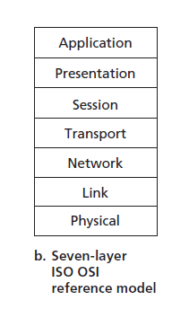
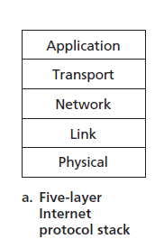
Reference Models for Layering

Slide 54
Internet protocol stack
application: supporting network applications
FTP, SMTP, HTTP
transport: process-process data transfer
TCP, UDP
network: routing of datagrams from source to destination
IP, routing protocols
link: data transfer between neighboring network elements
Ethernet, 802.11 (WiFi), PPP
physical: bits “on the wire”
application
transport
network
link
physical

Slide 55
Encapsulation
source
message
M
application
transport
network
link
physical
segment
H_{t}
M
H_{t}
datagram
H_{n}
H_{n}
H_{t}
M
frame
H_{l}
H_{n}
H_{t}
M
link
physical
switch
destination
H_{n}
H_{t}
M
network
link
physical
M
application
transport
network
link
physical
H_{l}
H_{n}
H_{t}
M
H_{n}
H_{t}
M
H_{t}
M
H_{n}
H_{t}
M
H_{l}
H_{n}
H_{t}
M
router

Slide 56
Chapter 1: roadmap
1.1 what is the Internet?
1.2 network edge
end systems, access networks, links
1.3 network core
packet switching, circuit switching, network structure
1.4 delay, loss, throughput in networks
1.5 protocol layers, service models
1.6 networks under attack: security
1.7 history
Notes:
‹#›

Slide 57
Network security
field of network security:
how bad guys can attack computer networks
how we can defend networks against attacks
how to design architectures that are immune to attacks
Internet not originally designed with (much) security in mind
original vision: “a group of mutually trusting users attached to a transparent network” ☺
Internet protocol designers playing “catch-up”
security considerations in all layers!

Slide 58
Bad guys: put malware into hosts via Internet
malware can get in host from:
virus: self-replicating infection by receiving/executing object (e.g., e-mail attachment)
worm: self-replicating infection by passively receiving object that gets itself executed
spyware malware can record keystrokes, web sites visited, upload info to collection site
infected host can be enrolled in botnet, used for spam. DDoS attacks

Slide 59
The 8 Most Famous Computer Viruses or malwares of All Time
CryptoLocker. When it comes to malware, ransomware is the new kid on the block. ...
ILOVEYOU. While ILOVEYOU sounds like a cheerful bon mot you might find printed on the inside of a Valentine's Day card, it's actually far, far more sinister than that. ...
MyDoom. ...
Storm Worm. ...
Anna Kournikova. ...
Slammer. ...
Stuxnet.

Slide 60

Bad guys: attack server, network infrastructure
Denial of Service (DoS): attackers make resources (server, bandwidth) unavailable to legitimate traffic by overwhelming resource with bogus traffic
1. select target
2. break into hosts around the network (see botnet)
3. send packets to target from compromised hosts
target

Slide 61
Bad guys can sniff packets
packet “sniffing”:
broadcast media (shared ethernet, wireless)
promiscuous network interface reads/records all packets (e.g., including passwords!) passing by
A
C
src:B dest:A payload
B
wireshark software used for end-of-chapter labs is a (free) packet-sniffer

Slide 62
Bad guys can use fake addresses
IP spoofing: send packet with false source address
A
C
src:B dest:A payload
B
… lots more on security (throughout, Chapter 8)

Slide 63
Chapter 1: roadmap
1.1 what is the Internet?
1.2 network edge
end systems, access networks, links
1.3 network core
packet switching, circuit switching, network structure
1.4 delay, loss, throughput in networks
1.5 protocol layers, service models
1.6 networks under attack: security
1.7 history
Notes:
‹#›

Slide 64
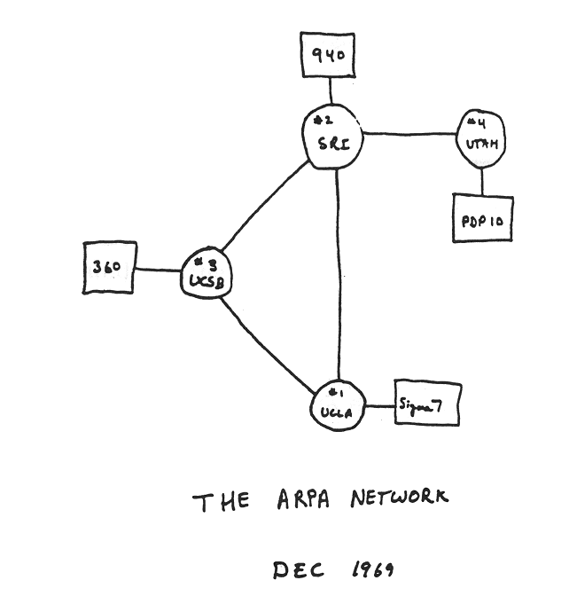
Internet history
1961-1972: Early packet-switching principles
1961: Kleinrock - queueing theory shows effectiveness of packet-switching
1964: Baran - packet-switching in military nets
1967: ARPAnet conceived by Advanced Research Projects Agency
1969: first ARPAnet node operational
1972:
ARPAnet public demo
NCP (Network Control Protocol) first host-host protocol
first e-mail program
ARPAnet has 15 nodes

Slide 65
Internet history
1972-1980: Internetworking, new and proprietary nets
1970: ALOHAnet satellite network in Hawaii
1974: Cerf and Kahn - architecture for interconnecting networks
1976: Ethernet at Xerox PARC
late70’s: proprietary architectures: DECnet, SNA, XNA
late 70’s: switching fixed length packets (ATM precursor)
1979: ARPAnet has 200 nodes
Cerf and Kahn’s internetworking principles:
minimalism, autonomy - no internal changes required to interconnect networks
best effort service model
stateless routers
decentralized control
define today’s Internet architecture

Slide 66
Internet history
1980-1990: new protocols, a proliferation of networks
1983: deployment of TCP/IP
1982: smtp e-mail protocol defined
1983: DNS defined for name-to-IP-address translation
1985: ftp protocol defined
1988: TCP congestion control
new national networks: Csnet, BITnet, NSFnet, Minitel
100,000 hosts connected to confederation of networks

Slide 67
Internet history
1990, 2000’s: commercialization, the Web, new apps
early 1990’s: ARPAnet decommissioned
1991: NSF lifts restrictions on commercial use of NSFnet (decommissioned, 1995)
early 1990s: Web
hypertext [Bush 1945, Nelson 1960’s]
HTML, HTTP: Berners-Lee
1994: Mosaic, later Netscape
late 1990’s: commercialization of the Web
late 1990’s – 2000’s:
more killer apps: instant messaging, P2P file sharing
network security to forefront
est. 50 million host, 100 million+ users
backbone links running at Gbps

Slide 68
Internet history
2005-present
~750 million hosts
Smartphones and tablets
Aggressive deployment of broadband access
Increasing ubiquity of high-speed wireless access
Emergence of online social networks:
Facebook: soon one billion users
Service providers (Google, Microsoft) create their own networks
Bypass Internet, providing “instantaneous” access to search, email, etc.
E-commerce, universities, enterprises running their services in “cloud” (eg, Amazon EC2)

Slide 69
Introduction: summary
covered a “ton” of material!
Internet overview
what’s a protocol?
network edge, core, access network
packet-switching versus circuit-switching
Internet structure
performance: loss, delay, throughput
layering, service models
security
history
you now have:
context, overview, “feel” of networking
more depth, detail to follow!

